Slide 1
Avtec and Harris Solutions
Notes:
No changes

Slide 2
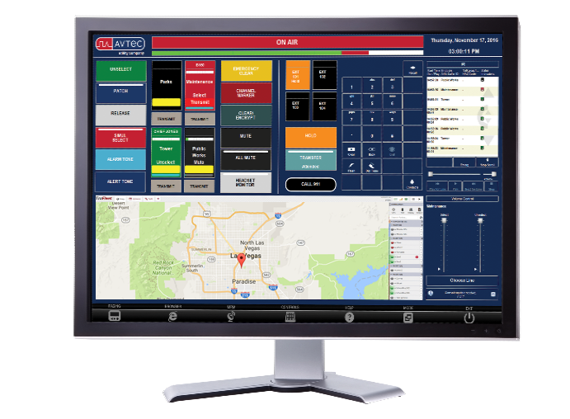
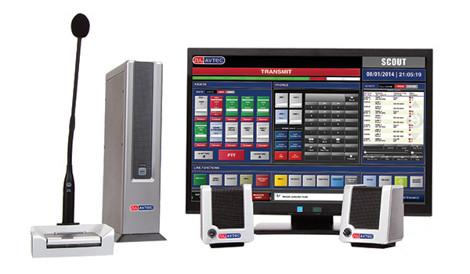
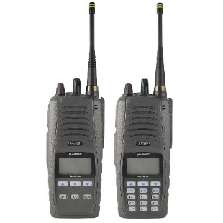



A DMR ecosystem built on open standards
LATITUDE: 36.132229
LONGITUDE: -115.155251
+
=
TM
A DMR ecosystem
of voice, mapping, and data

Slide 3
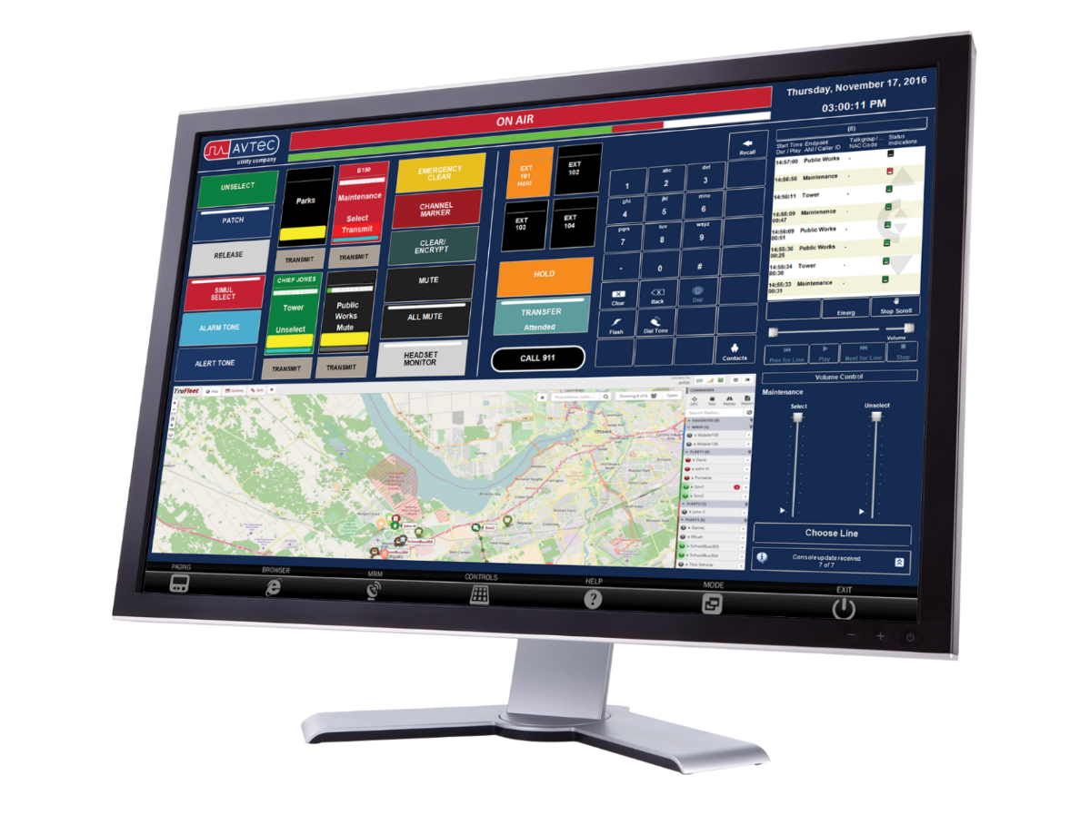
Avtec + EnableLocation: track radio resources in the field
Integrated voice, mapping, and data for faster, more informed decision-making

Slide 4

First Responders rely on Avtec VoIP dispatch solutions
Notes:
No changes

Slide 5

One platform. Multiple technologies
LTE
P25
LEGACY
DMR
TRUNKED
Scout VoIP
Dispatch Console
CONVENTIONAL
TELEPHONY
ANALOG SIMULCAST

Slide 6
A DMR ecosystem built on open standards
LATITUDE: 36.132229
LONGITUDE: -115.155251
+
=
TM
A DMR ecosystem
of voice, mapping, and data

Slide 7







Field-tested integrated solutions
+
SOME OF OUR JOINT UTILITY ACCOUNTS

Slide 8





Field-tested integrated solutions
+
SOME OF OUR JOINT PUBLIC SAFETY ACCOUNTS

Slide 9

Utilities rely on Avtec VoIP dispatch solutions
Use Utility Map

Slide 10

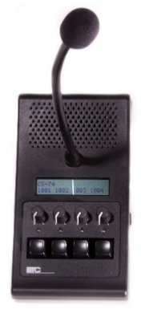
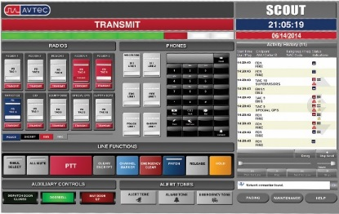
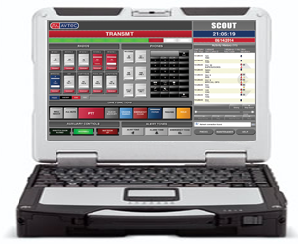
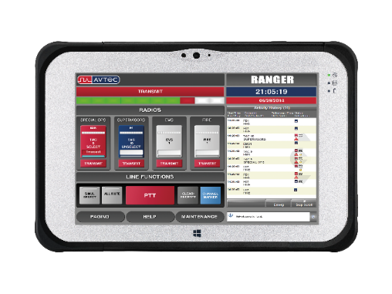
A suite of Avtec dispatch solutions for Harris radio systems
Fixed and mobile VoIP dispatch console solutions that integrate
with Harris DMR and P25 conventional radio platforms
SCOUT
MOBILE SCOUT
RANGER
MINI SIP
Fixed-location dispatch offers full-feature functionality
Full-featured console for dispatch on the go
Mobile dispatch for up to four radio talkgroups
Four-channel IP device using Power over Ethernet

Slide 11
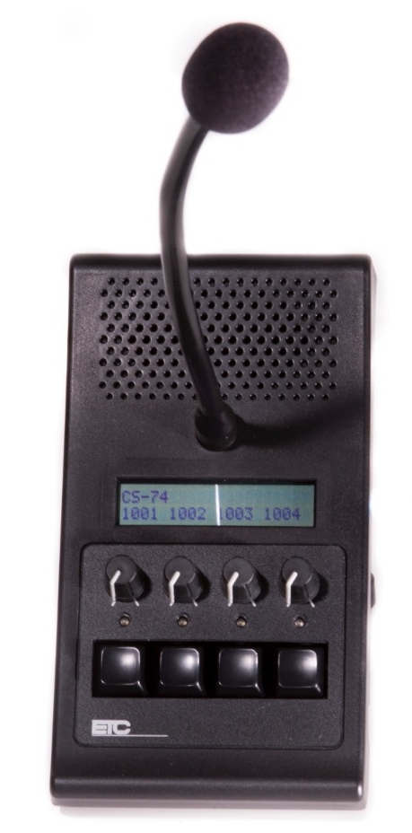
Avtec Mini SIP Console keeps you connected
Simplified IP dispatch device
PTT and radio monitoring
One plug for easy installation
Access communications wherever you have secure network access

Slide 12

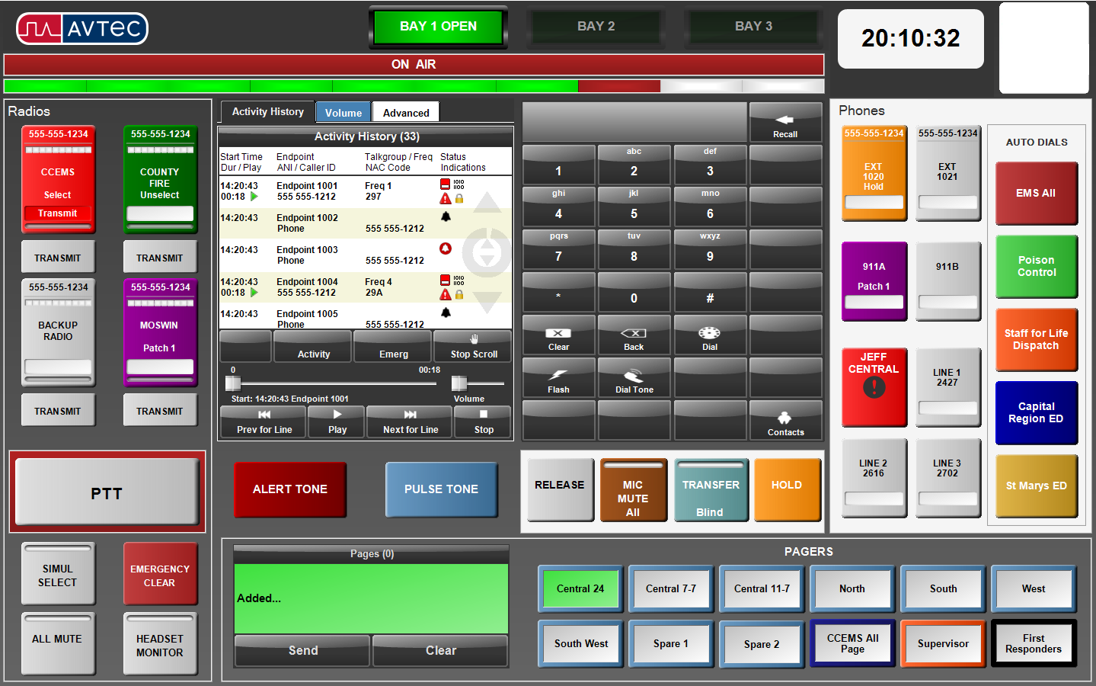
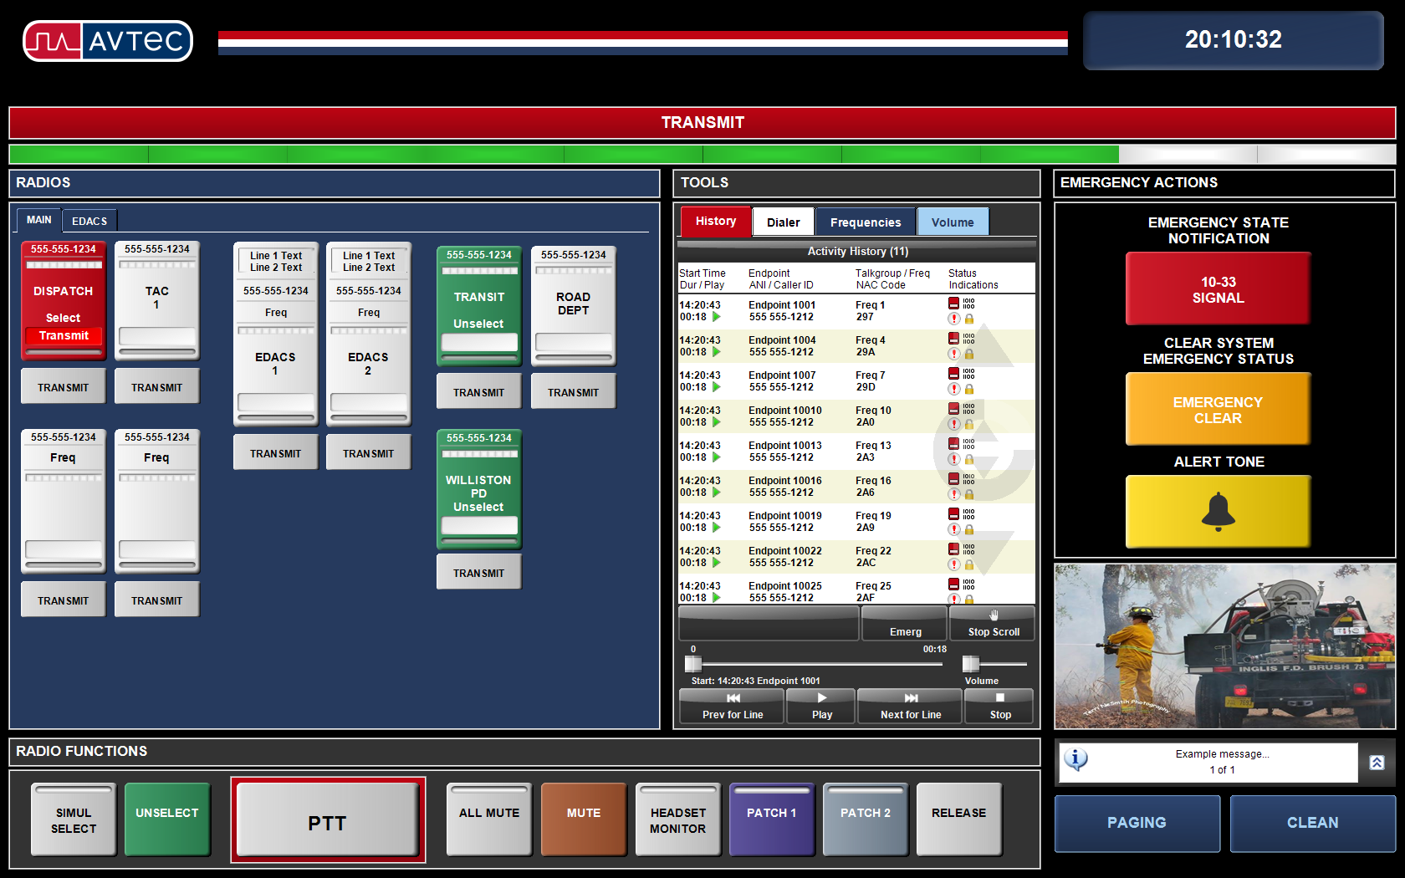
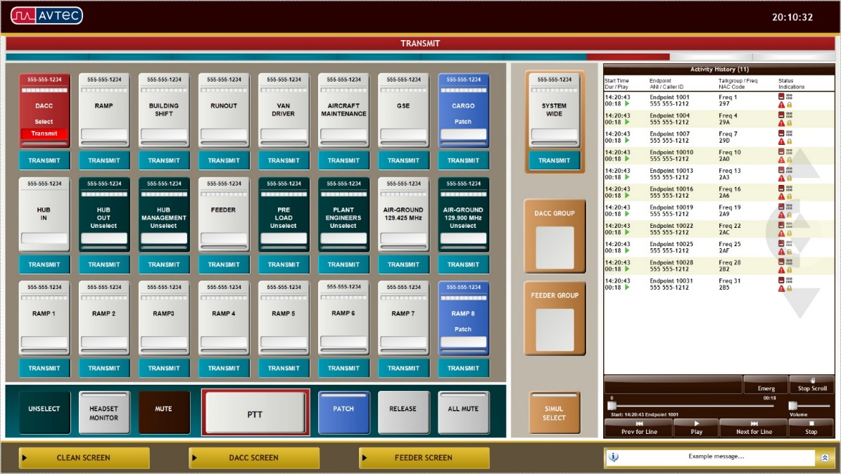
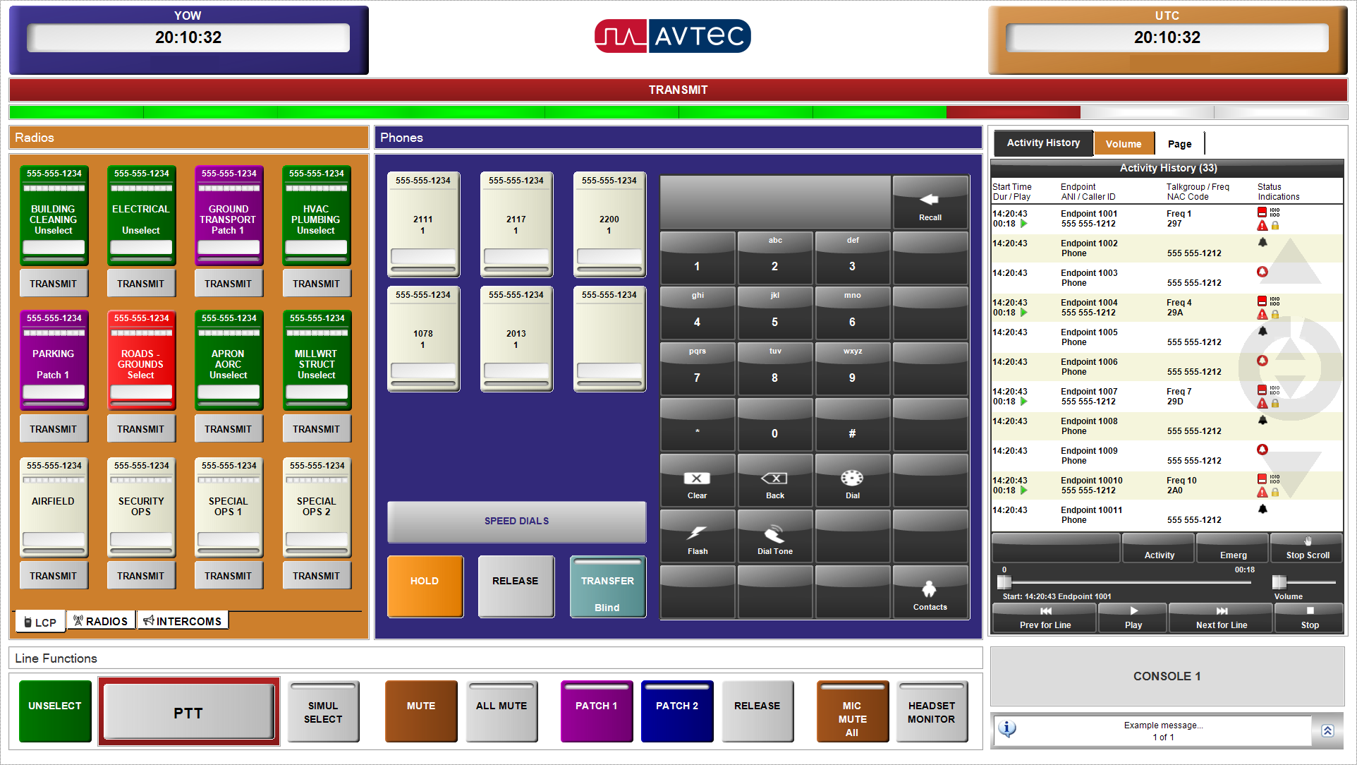
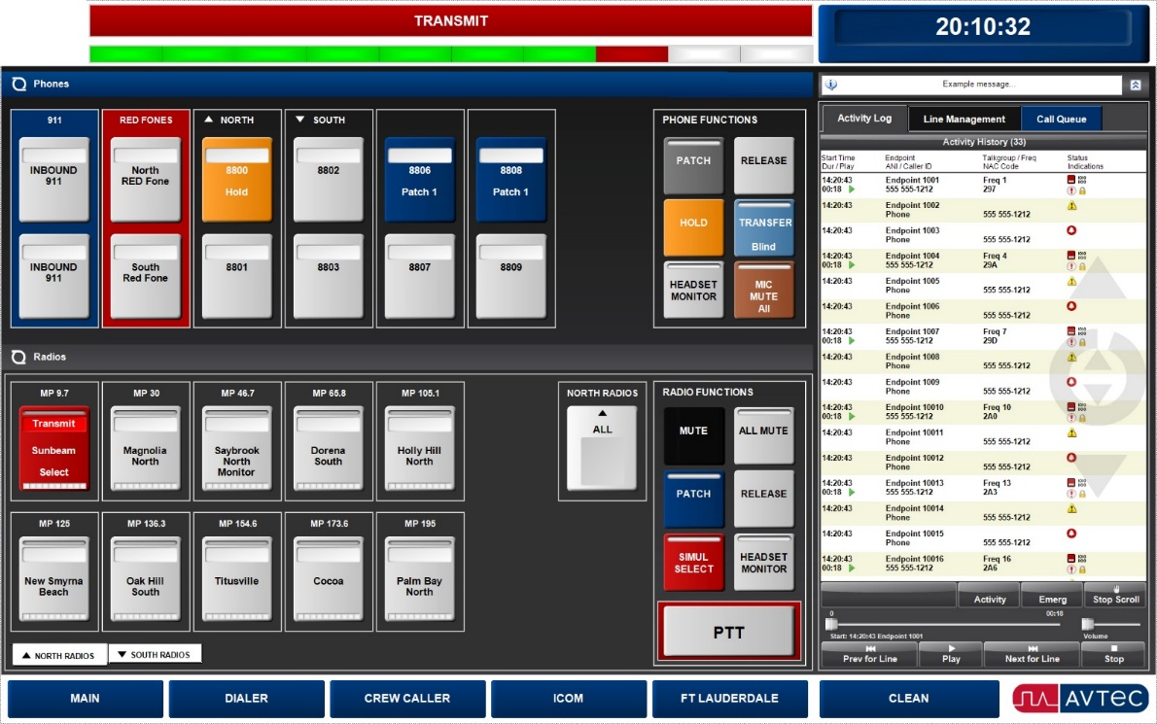
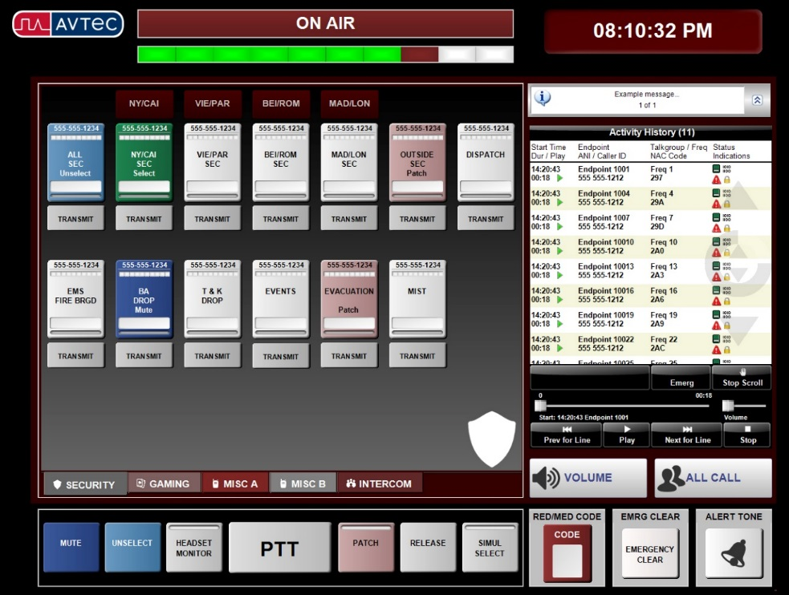
100% customizable GUI that exactly fits your operations
Notes:
Can we have the one monitor and rotate each screen within the monitor?

Slide 13
A DMR Ecosystem Built on Open Standards
LATITUDE: 36.132229 LONGITUDE: -115.155251
+
=
TM
A DMR ecosystem
of voice, mapping, and data

Slide 14
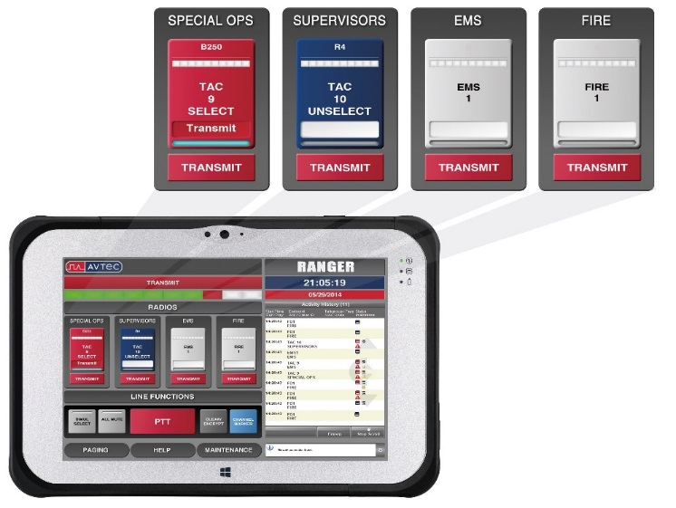
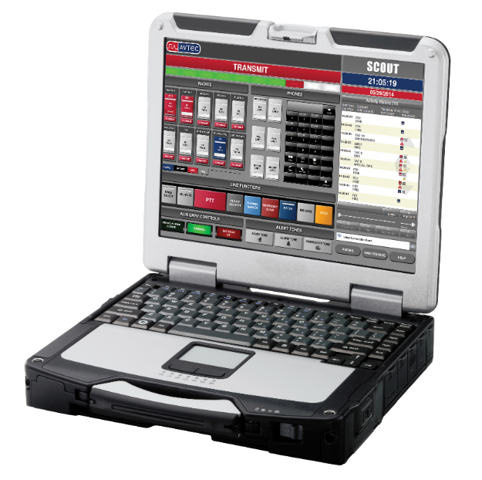
Go mobile with Avtec Ranger or Mobile Scout
Two mobile dispatch options
Full-featured IP Console
Via 4G LTE or Wi-Fi
Windows® laptop or tablet
Four Channel Communications
Via 4G LTE or Wi-Fi
Windows® laptop or tablet
RANGER
MOBILE SCOUT

Slide 15


Change picture to B&I
Business & Manufacturing Industries Rely on
Avtec VoIP Dispatch Solutions

Slide 16
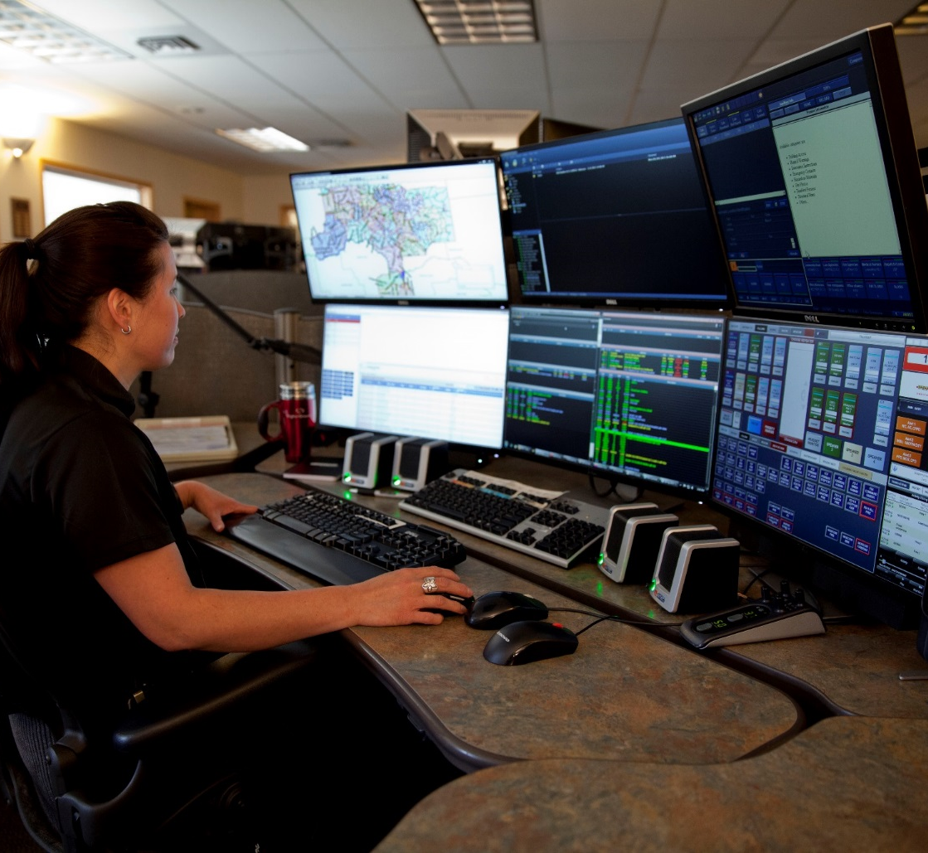
Avtec VoIP dispatch solutions with Harris radio systems
  Go mobile with dispatch communications on your laptop or tablet
  Intercom between dispatchers for effective communications
  Easily manage multi-agency response
  Integrated instant recall recorder for quick replay of radio and telephony calls
  Customize the console GUI to exactly meet your operational needs

Slide 17
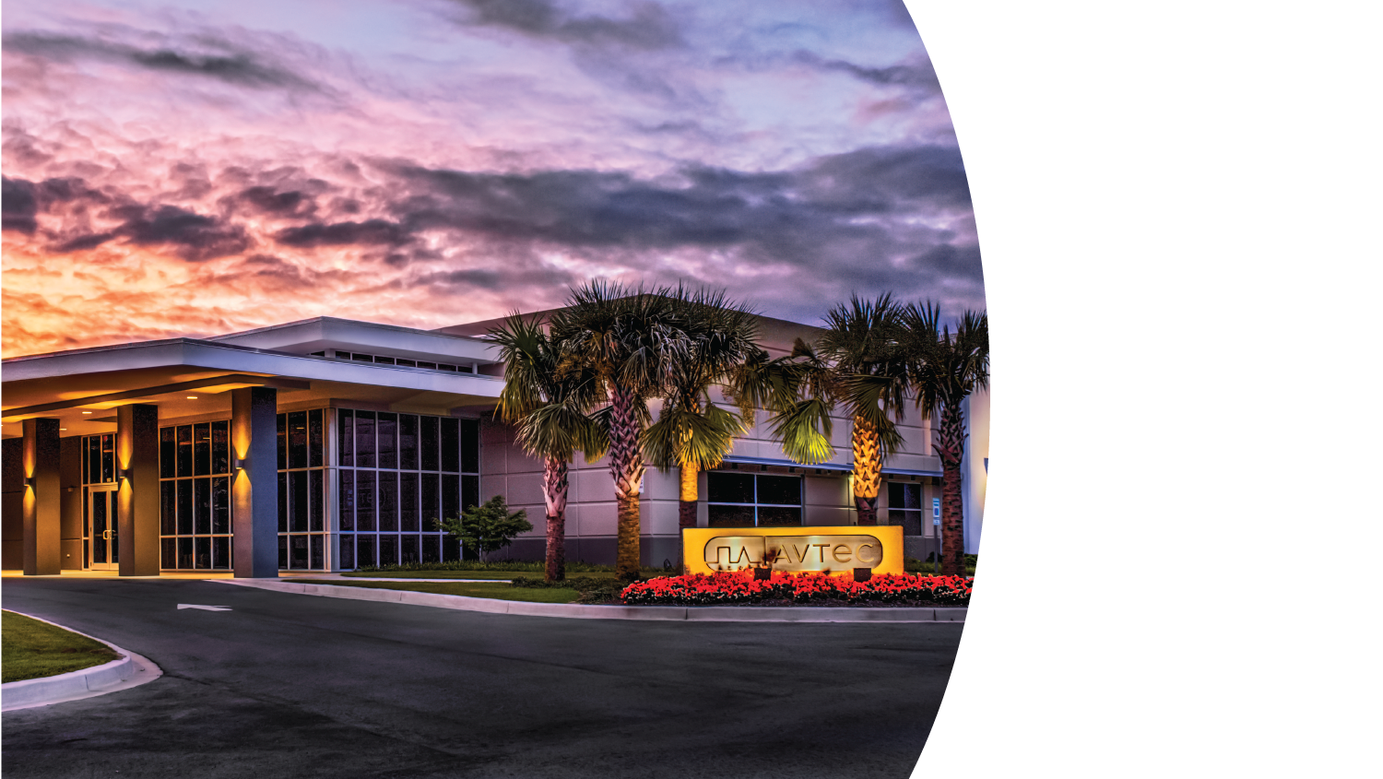

Proven Integration with Harris Infrastructure
End-to-End IP Architecture
Multiple Form Factors for Different Deployment Scenarios
Made in America

